Slide 1

Reviewing Student Equity & Achievement Metrics
Dominique Benavides, Director of College Research & Planning
September 21, 2022

Slide 2
Which metrics will be evaluated?
Successful Enrollment in the First Year
Persisted First Primary Term to Subsequent Primary Term
Completed Both Transfer Level Math and English
Transferred to a Four-Year Institution
Attained the Vision Goal Completion Definition

Slide 3
What are the Student Equity Groups?
Primary Subgroups | Primary Disaggregated Subgroups
Gender | Female
Gender | Male
Gender | Unknown/Non-Respondent
Ethnicity | American Indian/Alaska Native
Ethnicity | Asian
Ethnicity | Black or African American
Ethnicity | Filipino
Ethnicity | Hispanic
Ethnicity | Pacific Islander or Hawaiian Native
Ethnicity | White
Ethnicity | Two or More Races
Perkins Economically Disadvantaged | Perkins Economically Disadvantaged
Perkins Economically Disadvantaged | Not Perkins Economically Disadvantaged
First Generation | First Generation Student
First Generation | Not First-Generation Student
First Generation | Unknown/Unreported
Foster Youth | Foster Youth
Foster Youth | Not Foster Youth
DSPS | Student Who Received Disability Services
DSPS | Not a Student Who Received Disability Services
Veterans | Veteran
Veterans | Not Veteran
LGBT | LGBT
LGBT | Non-LGBT
Homeless | Homeless
Homeless | Not Homeless

Slide 4
What is Disproportionate Impact?
  Disproportionate impact occurs when a subset of students based on a student characteristic such as age, race, or gender have observably different outcomes when compared to the total student population.
Source: CCCCO Percentage Point Gap Update

Slide 5

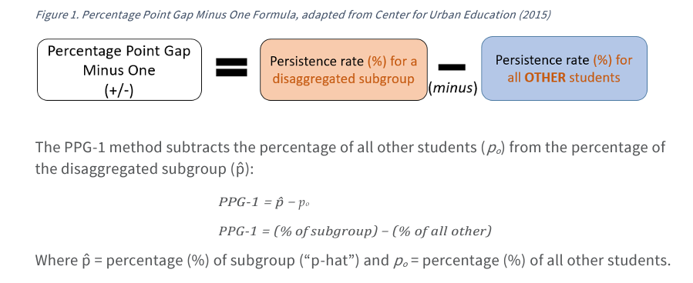
Percentage Point Gap Minus One
(PPG-1) Method

Slide 6
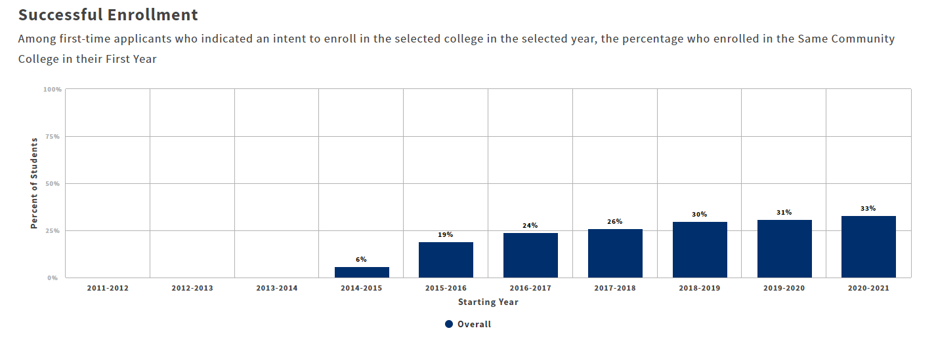
Source: CCC Student Success Metrics Cohort View https://www.calpassplus.org/Launchboard/Student-Success-Metrics-Cohort-View

Slide 7


Successful Enrollment in the First Year
Among first-time applicants who indicated an intent to enroll in the selected college in the selected year, the percentage who enrolled in the Same Community College in their First Year
No. of students that enrolled
(numerator)
288
No. of CCC Apply applicants
(denominator)
870
% who enrolled
(overall percent)
33%
Primary Equity Group | Gender | Numerator | Denominator | Subgroup Outcome Rate
Primary Equity Group | Female Students | 125 | 461 | 27%
All Other Students | Male Students | 159 | 399 | 13%
All other students | Unknown/Non-Respondent | 4 | 10 | 7%
TOTAL All other students |  | 163 | 409 | 40%
Percentage Point Gap Method Minus One (PPG -1)
−
-13%
Percentage Point Gap minus one (+/-)
27%
Primary Equity Group
40%
All Other Students
Source: CCC Student Equity & Achievement files (340_108667_REVISED_20220801)

Slide 8
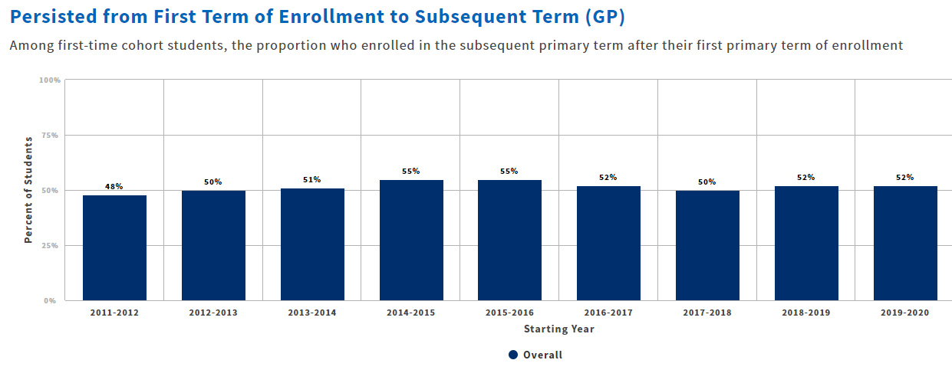
Source: CCC Student Success Metrics Cohort View
https://www.calpassplus.org/Launchboard/Student-Success-Metrics-Cohort-View

Slide 9
  Persisted First Primary Term to Subsequent Primary Term
Among first-time cohort students, the proportion who enrolled in the subsequent primary term after their first primary term of enrollment
No. of first-time students who persisted to the next primary term
(numerator)
470
No. of first-time students
enrolled in Fall 19
(denominator)
906
% retained
(overall percent)
52%
The table below reflects the subgroups who have been determined to be disproportionately impacted using the percentage point gap method in 2019-20
Subgroups with a percentage point gap of 3% or more suggest a disproportionate impact exists.
Primary Equity Group (Race/Ethnicity) | Numerator | Denominator | Subgroup Outcome Rate | Subgroup Outcome Rate (for all other students) | Percentage Point Gap (% of subgroup) − (% of all other)
Black or African American | 52 | 130 | 40% | 54% | -14%
Gender Disaggregated Subgroup | Numerator | Denominator | Subgroup Outcome Rate | Subgroup Outcome Rate (for all other students) | Percentage Point Gap (% of subgroup) − (% of all other)
Black or African American – Male | 25 | 67 | 37% | 43% | -6%
Source: CCC Student Equity & Achievement files (340_108667_REVISED_20220801)

Slide 10
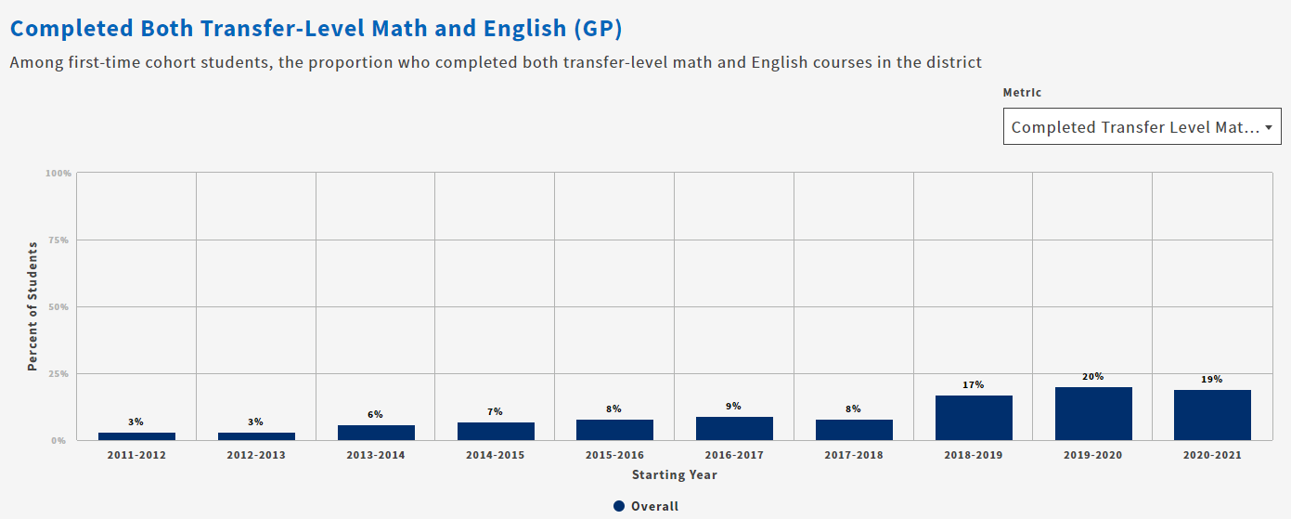
Source: CCC Student Success Metrics Cohort View
https://www.calpassplus.org/Launchboard/Student-Success-Metrics-Cohort-View

Slide 11
  Completed Both Transfer - Level Math and English
Excluding high school students, the proportion of all students who completed transfer-level Math and English in their first academic year of credit enrollment within PCCD.
No. of 1st time students that successfully completed Transfer Math & English in 1st year (numerator)
149
No. of 1st time students who enrolled in a credit course within PCCD
(denominator)
802
% of students who successfully completed
Transfer Math and English
(overall percent)
19%
The table below reflects the subgroups who have been determined to be disproportionately impacted using the percentage point gap method in 2020-21.
Subgroups with a percentage point gap of 3% or more suggest a disproportionate impact exists.
Primary Equity Groups | Numerator | Denominator | Subgroup Outcome Rate | Subgroup Outcome Rate (for all other students) | Percentage Point Gap (% of subgroup) − (% of all other)
Black or African American | 12 | 112 | 11% | 20% | -9%
Hispanic/Latinx | 26 | 196 | 13% | 20% | -7%
Foster Youth | 1 | 18 | 6% | 19% | -13%
Homeless | 0 | 12 | 0% | 19% | -19%
Source: CCC Student Equity & Achievement files (340_108667_REVISED_20220801)

Slide 12
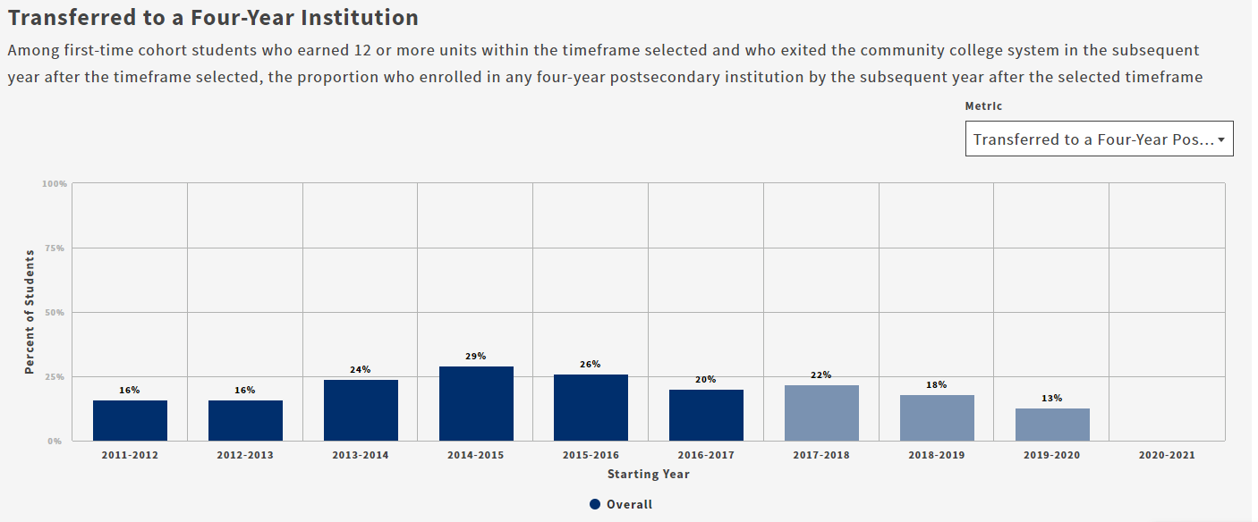
Source: CCC Student Success Metrics Cohort View
https://www.calpassplus.org/Launchboard/Student-Success-Metrics-Cohort-View

Slide 13
  Transferred to Four Year Institution
Using 2016-17 data and excluding high school students, the proportion of first-time cohort students who earned 12 units or more and exited in the subsequent year and enrolled in any four-year postsecondary institution.
No. of students that transferred
(numerator)
112
First time student cohort +12 units
(denominator)
551
% who transferred
(overall percent)
20%
The table below reflects the subgroups who have been determined to be disproportionately impacted using the percentage point gap method in 2016-17.
Subgroups with a percentage point gap of 3% or more suggest a disproportionate impact exists.
Primary Equity Groups | Numerator | Denominator | Subgroup Outcome Rate | Subgroup Outcome Rate (for all other students) | Percentage Point Gap (% of subgroup) − (% of all other)
Hispanic/Latinx | 14 | 129 | 11% | 23% | -12%
First Generation Students | 40 | 233 | 17% | 23% | -6%
Students Who Received Disability Services | 3 | 33 | 9% | 21% | -12%
Foster Youth | 0 | 10 | 0% | 21% | -21%
Source: CCC Student Equity & Achievement files (340_108667_REVISED_20220801)

Slide 14
  Attained the Vision Goal Completion Definition
Excluding high school students, the proportion of first-time cohort students who attained one of the following: earned an AA, AS, AAT, and or AST; earned a Chancellor’s office approved credit certificate, earned a noncredit certificate, attained apprenticeship journey status, or transferred to four-year postsecondary institution in 2017-18.
No. of students that attained Vision Goal by 2017-18
(numerator)
78
First-time student cohort
(denominator)
1038
% that attained
Vision Goal
(overall percent)
8%
The table below reflects the subgroups who have been determined to be disproportionately impacted using the percentage point gap method in 2017-18.
Subgroups with a percentage point gap of 3% or more suggest a disproportionate impact exists.
Primary Equity Groups | Numerator | Denominator | Subgroup Outcome Rate | Subgroup Outcome Rate (for all other students) | Percentage Point Gap (% of subgroup) − (% of all other)
Male Students | 28 | 477 | 6% | 9% | -3%
LGBT | 0 | 37 | 0% | 8% | -8%
Source: CCC Student Equity & Achievement files (340_108667_REVISED_20220801)

