Slide 1
President’s Flex Day presentation By Nathaniel Jones III, ph.D., MBA August 20, 2021

Slide 2
Happiness cannot be traveled to, owned, earned, worn or consumed. Happiness is the spiritual experience of living every minute with love, grace and gratitude.
Denis Waitley
THANK YOU!

Slide 3
Welcome to AY21/22
HIGHLIGHT TOPICS
Congratulations
President’s Office Hours
Hiring Updates
The elephant in the room

Slide 4
District Highlights Chancellor Jackson August 19, 2021
- Community Value
- Union Contract Negotiations
-Return to Campus (Safe Peralta)
- Accreditation Update
- IT Upgrades
- AY21/22 Budget Overview

Slide 5
COA Return to Campus Update
Priority #1 – Safety, Security & Wellbeing of our students, faculty & staff
Modest increase in F2F courses (Dance, Math, Physics, & Psychology)
In person Mental Health Services and Bookstore
Installation of Air Purifying units
Masks and hand sanitizers in instructional spaces
Public Health & Wayfinding Signage
Controlled ingress and egress to buildings
Promoting social distancing
Established an administrative lead (Dr. Tina Vasconcellos, VPSS)

Slide 6
AY21/22 Priorities
Diversity (DEI)
Guided Pathways
Strategic Enrollment Mgmt.
Fiscal Stewardship

Slide 7
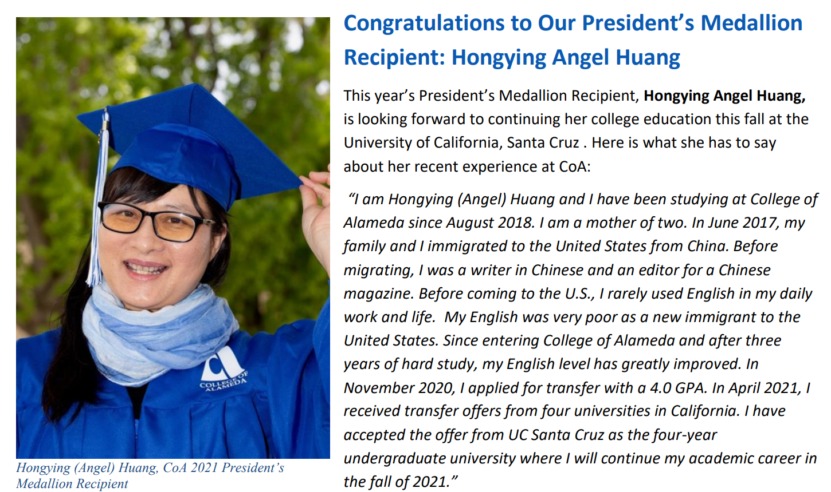
Conclusion
Keep up the good work we do; but with Positivity
Be bold & courageous
Remember, our work can transform lives so do it with excellence and compassion!

Slide 8
Questions & Answers
THANK You!

