Slide 1
College of Alameda 2021-22 FTEF Allocation Overview January 29, 2021
Dr. Don Miller,
Vice President of Instruction
Dominique Benavides,
Director of College Research & Planning

Slide 2
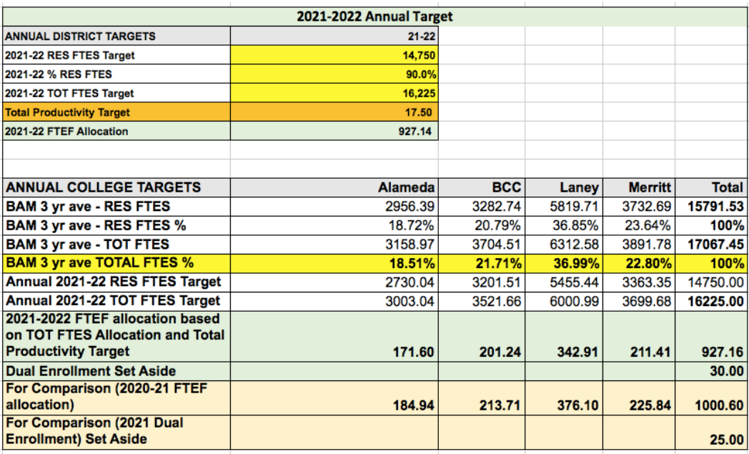

Slide 3
Planning scenarios
Three-year FTEF average​
FTES for Financial Aid Students - SCFF
(PELL & California Promise Grant recipients)
Productivity ​2019-20 ​
Course Demand
Comprehensive Student Education Plans (SEPs)
Awards Conferred ​- SCFF
Course Success Rates​
Course Retention Rates

Slide 4
Scenario #1 Three-year FTEF average
Discipline | 2017-18 FTEF | 2018-19 FTEF | 2019-20 FTEF | 3-year average FTEF | % of Total FTEF | Projected FTEF - 3Y AVG | Variance
ADAM | 5.3 | 5.3 | 5.3 | 5.3 | 2.5% | 4.2 | -1.0
AFRAM | 1.6 | 1.8 | 1.8 | 1.7 | 0.8% | 1.4 | -0.3
AMT | 11.6 | 10.1 | 12.2 | 11.3 | 5.3% | 9.0 | -2.2
ANTHR | 3.6 | 4.2 | 4.2 | 4.0 | 1.9% | 3.2 | -0.8
ART | 4.5 | 5.2 | 4.5 | 4.7 | 2.2% | 3.8 | -0.9
ASTR | 1.4 | 1.2 | 0.8 | 1.1 | 0.5% | 0.9 | -0.2
ATECH | 12.9 | 12.1 | 10.9 | 12.0 | 5.6% | 9.6 | -2.4
ATHL | 1.4 | 1.3 | 1.9 | 1.5 | 0.7% | 1.2 | -0.3
AUTOB | 4.6 | 4.6 | 4.6 | 4.6 | 2.2% | 3.7 | -0.9
BIOL | 14.8 | 13.1 | 11.8 | 13.2 | 6.2% | 10.6 | -2.6
BUS | 8.6 | 7.4 | 6.5 | 7.5 | 3.5% | 6.0 | -1.5
CHEM | 7.0 | 6.5 | 6.2 | 6.5 | 3.1% | 5.2 | -1.3
CHIN | 1.3 | 1.3 | 1.3 | 1.3 | 0.6% | 1.1 | -0.3
CIS | 9.5 | 9.6 | 7.9 | 9.0 | 4.2% | 7.2 | -1.8
COMM | 5.4 | 6.9 | 5.2 | 5.8 | 2.7% | 4.7 | -1.2
COPED | 0.5 | 0.7 | 0.6 | 0.6 | 0.3% | 0.5 | -0.1
COUN | 3.2 | 2.7 | 2.6 | 2.8 | 1.3% | 2.3 | -0.6
DANCE | 2.0 | 2.0 | 2.0 | 2.0 | 0.9% | 1.6 | -0.4
DENTL | 5.2 | 5.3 | 6.5 | 5.7 | 2.6% | 4.5 | -1.1
DMECH | 4.2 | 4.2 | 4.6 | 4.3 | 2.0% | 3.5 | -0.9
ECON | 4.8 | 4.8 | 4.2 | 4.6 | 2.1% | 3.7 | -0.9
Discipline | 2017-18 FTEF | 2018-19 FTEF | 2019-20 FTEF | 3-year average FTEF | % of Total FTEF | Projected FTEF - 3Y AVG | Variance
ENGL | 20.0 | 18.9 | 18.1 | 19.0 | 8.9% | 15.2 | -3.8
ESOL | 13.5 | 13.4 | 12.9 | 13.3 | 6.2% | 10.6 | -2.6
GEOG | 4.4 | 4.3 | 3.1 | 3.9 | 1.8% | 3.1 | -0.8
GEOL | 0.4 | 0.4 | 0.4 | 0.4 | 0.2% | 0.3 | -0.1
HIST | 6.0 | 6.2 | 6.0 | 6.1 | 2.8% | 4.9 | -1.2
HLTED | 0.1 | 0.1 | 0.1 | 0.1 | 0.1% | 0.1 | 0.0
HLTOC | 1.9 | 2.1 | 1.3 | 1.8 | 0.8% | 1.4 | -0.4
HUMAN | 2.4 | 2.2 | 1.6 | 2.1 | 1.0% | 1.7 | -0.4
KIN | 3.2 | 3.3 | 2.6 | 3.0 | 1.4% | 2.4 | -0.6
LIS | 0.4 | 0.4 | 0.5 | 0.4 | 0.2% | 0.4 | -0.1
LRNRE | 4.5 | 4.2 | 3.9 | 4.2 | 2.0% | 3.4 | -0.8
MATH | 25.0 | 23.9 | 21.3 | 23.4 | 10.9% | 18.8 | -4.7
MUSIC | 2.5 | 2.7 | 3.2 | 2.8 | 1.3% | 2.2 | -0.6
PHIL | 1.2 | 1.0 | 0.6 | 0.9 | 0.4% | 0.7 | -0.2
PHYS | 2.9 | 2.9 | 2.5 | 2.8 | 1.3% | 2.2 | -0.6
POSCI | 5.0 | 4.8 | 3.0 | 4.3 | 2.0% | 3.4 | -0.8
PSYCH | 9.2 | 9.0 | 6.4 | 8.2 | 3.8% | 6.6 | -1.6
SOC | 4.2 | 4.6 | 4.6 | 4.5 | 2.1% | 3.6 | -0.9
SPAN | 2.5 | 2.0 | 2.0 | 2.2 | 1.0% | 1.7 | -0.4
VIET | 1.3 | 1.0 | 0.7 | 1.0 | 0.5% | 0.8 | -0.2
TOTAL | 224.1 | 217.8 | 200.6 | 214.2 | 100.0% | 171.6 | -42.6

Slide 5
Scenario #2 FTES by discipline – Financial Aid Students
Discipline | 2019-20 FTES by FA | 2019-20 FTES | Financial Aid Percent | % to total | Projected FTEF - FA FTES
ADAM | 47.7 | 81.6 | 59% | 2.6% | 4.5
AFRAM | 20.2 | 27.3 | 74% | 1.1% | 1.9
AMT | 141.8 | 230.9 | 61% | 7.8% | 13.5
ANTHR | 58.8 | 100.6 | 58% | 3.3% | 5.6
ART | 49.3 | 93.8 | 53% | 2.7% | 4.7
ASTR | 15.4 | 29.2 | 53% | 0.9% | 1.5
ATECH | 61.7 | 116.3 | 53% | 3.4% | 5.9
ATHL | 13.4 | 20.1 | 67% | 0.7% | 1.3
AUTOB | 20.0 | 40.0 | 50% | 1.1% | 1.9
BIOL | 95.8 | 206.5 | 46% | 5.3% | 9.1
BUS | 51.2 | 90.3 | 57% | 2.8% | 4.9
CHEM | 36.8 | 86.2 | 43% | 2.0% | 3.5
CHIN | 19.3 | 22.3 | 87% | 1.1% | 1.8
CIS | 62.4 | 120.8 | 52% | 3.5% | 5.9
COMM | 67.6 | 113.5 | 60% | 3.7% | 6.4
COPED | 2.8 | 10.8 | 25% | 0.2% | 0.3
COUN | 32.1 | 54.9 | 59% | 1.8% | 3.0
DANCE | 37.1 | 45.5 | 82% | 2.1% | 3.5
DENTL | 53.2 | 56.6 | 94% | 2.9% | 5.0
DMECH | 31.3 | 65.0 | 48% | 1.7% | 3.0
ECON | 47.1 | 86.0 | 55% | 2.6% | 4.5
Discipline | 2019-20 FTES by FA | 2019-20 FTES | Financial Aid Percent | % to total | Projected FTEF - FA FTES
ENGL | 137.8 | 248.1 | 56% | 7.6% | 13.1
ESOL | 98.8 | 156.5 | 63% | 5.5% | 9.4
GEOG | 37.1 | 66.7 | 56% | 2.1% | 3.5
GEOL | 2.8 | 5.8 | 47% | 0.2% | 0.3
HIST | 72.7 | 128.1 | 57% | 4.0% | 6.9
HLTED | 1.1 | 1.5 | 73% | 0.1% | 0.1
HLTOC | 16.4 | 37.0 | 44% | 0.9% | 1.6
HUMAN | 17.7 | 30.6 | 58% | 1.0% | 1.7
KIN | 15.6 | 33.1 | 47% | 0.9% | 1.5
LIS | 5.2 | 8.5 | 61% | 0.3% | 0.5
LRNRE | 6.4 | 8.6 | 74% | 0.8% | 1.4
MATH | 184.1 | 353.9 | 52% | 10.2% | 17.5
MUSIC | 20.1 | 42.6 | 47% | 1.1% | 1.9
PHIL | 8.0 | 14.8 | 54% | 0.4% | 0.8
PHYS | 15.3 | 35.4 | 43% | 0.8% | 1.5
POSCI | 30.3 | 63.8 | 47% | 1.7% | 2.9
PSYCH | 76.8 | 134.7 | 57% | 4.2% | 7.3
SOC | 75.0 | 120.0 | 63% | 4.1% | 7.1
SPAN | 7.0 | 21.2 | 33% | 0.4% | 0.7
VIET | 6.0 | 9.5 | 63% | 0.3% | 0.6
TOTAL | 1808.0 | 3233.0 | 56% | 171.60 | 171.6

Slide 6
Scenario #3 Productivity
Discipline | 2019-20 FTES | 2019-20 FTEF | 2019-20 PROD | Projected FTEF based upon PROD
ADAM | 81.6 | 5.3 | 15.5 | 4.2
AFRAM | 27.3 | 1.8 | 15.2 | 1.4
AMT | 230.9 | 12.2 | 18.9 | 12.2
ANTHR | 100.6 | 5.2 | 19.2 | 5.2
ART | 93.8 | 5.3 | 17.6 | 5.3
ASTR | 29.2 | 1.6 | 18.2 | 1.6
ATECH | 116.3 | 10.9 | 10.6 | 6.0
ATHL | 20.1 | 1.9 | 10.4 | 1.1
AUTOB | 40.0 | 4.6 | 8.7 | 2.5
BIOL | 206.5 | 12.8 | 16.1 | 11.6
BUS | 90.3 | 6.7 | 13.4 | 4.7
CHEM | 86.2 | 6.2 | 13.9 | 4.3
CHIN | 22.3 | 1.3 | 16.7 | 1.2
CIS | 120.8 | 7.9 | 15.2 | 6.4
COMM | 113.5 | 6.4 | 17.7 | 6.4
COPED | 10.8 | 1.1 | 9.8 | 0.6
COUN | 54.9 | 3.2 | 17.2 | 2.9
DANCE | 45.5 | 2.0 | 22.7 | 2.0
DENTL | 56.6 | 6.5 | 8.7 | 3.6
DMECH | 65.0 | 4.6 | 14.2 | 3.2
ECON | 86.0 | 5.4 | 15.9 | 4.3
Discipline | 2019-20 FTES | 2019-20 FTEF | 2019-20 PROD | Projected FTEF based upon PROD
ENGL | 248.1 | 19.2 | 12.9 | 11.5
ESOL | 156.5 | 12.9 | 12.2 | 7.1
GEOG | 66.7 | 3.9 | 17.2 | 3.5
GEOL | 5.8 | 0.4 | 14.6 | 0.3
HIST | 128.1 | 7.6 | 16.9 | 6.8
HLTED | 1.5 | 0.1 | 11.0 | 0.1
HLTOC | 37.0 | 2.4 | 15.5 | 1.9
HUMAN | 30.6 | 2.0 | 15.3 | 1.6
KIN | 33.1 | 3.0 | 11.1 | 1.6
LIS | 8.5 | 0.5 | 15.9 | 0.4
LRNRE | 23.2 | 3.9 | 5.9 | 2.1
MATH | 353.9 | 21.3 | 16.6 | 19.2
MUSIC | 42.6 | 3.2 | 13.5 | 2.2
PHIL | 14.8 | 1.0 | 14.8 | 0.7
PHYS | 35.4 | 2.5 | 14.1 | 1.8
POSCI | 63.8 | 4.4 | 14.5 | 3.1
PSYCH | 134.7 | 7.6 | 17.7 | 7.6
SOC | 120.0 | 6.2 | 19.4 | 6.2
SPAN | 21.2 | 2.0 | 10.6 | 1.1
VIET | 9.5 | 0.7 | 14.3 | 0.5
TOTAL | 3233.0 | 217.9 | 14.8 | 170.1

Slide 7
Scenario #4 Demand - Student Education Plans (SEPs)
Discipline | 2020-21 SEP Demand** | % Of Total Demand | FTEF using 100% demand
ADAM | 90 | 0.7% | 1.2
AFRAM | 255 | 2.0% | 3.4
AMT | 60 | 0.5% | 0.8
ANTHR | 414 | 3.2% | 5.5
ART | 263 | 2.0% | 3.5
ASTR | 43 | 0.3% | 0.6
ATECH | 38 | 0.3% | 0.5
ATHL | 2 | 0.0% | 0.0
AUTOB | 2 | 0.0% | 0.0
BIOL | 1269 | 9.8% | 16.8
BUS | 747 | 5.8% | 9.9
CHEM | 691 | 5.3% | 9.2
CHIN | 37 | 0.3% | 0.5
CIS | 716 | 5.5% | 9.5
COMM | 619 | 4.8% | 8.2
COPED | 52 | 0.4% | 0.7
COUN | 162 | 1.3% | 2.1
DANCE | 28 | 0.2% | 0.4
DENTL | 63 | 0.5% | 0.8
DMECH | 16 | 0.1% | 0.2
ECON | 389 | 3.0% | 5.2
Discipline | 2020-21 SEP Demand** | % Of Total Demand | FTEF using 100% demand
ENGL | 1489 | 11.5% | 19.7
ESOL | 405 | 3.1% | 5.4
GEOG | 272 | 2.1% | 3.6
GEOL | 41 | 0.3% | 0.5
HIST | 299 | 2.3% | 4.0
HLTED | 62 | 0.5% | 0.8
HLTOC | 9 | 0.1% | 0.1
HUMAN | 110 | 0.8% | 1.5
KIN | 43 | 0.3% | 0.6
LIS | 26 | 0.2% | 0.3
LRNRE | 0 | 0.0% | 0.0
MATH | 2220 | 17.1% | 29.4
MUSIC | 202 | 1.6% | 2.7
PHIL | 90 | 0.7% | 1.2
PHYS | 250 | 1.9% | 3.3
POSCI | 426 | 3.3% | 5.6
PSYCH | 528 | 4.1% | 7.0
SOC | 394 | 3.0% | 5.2
SPAN | 128 | 1.0% | 1.7
VIET | 8 | 0.1% | 0.1
TOTAL | 12958 | 100% | 171.6

Slide 8
Scenario #5 Awards Conferred - SCFF
Discipline | 2017-18 Awards | 2018-19 Awards | 2019-20 Awards | Liberal Arts, Natural Science, & Transfer Studies | 3 Year Average | % to Total | FTEF using 100% Awards Conferred
ADAM | 16 | 21 | 19 | 1 | 14 | 4% | 7.0
AFRAM | 1 | 3 | 0 | 5 | 2 | 1% | 1.2
AMT | 36 | 57 | 71 | 0 | 41 | 12% | 20.4
ANTHR | 0 | 0 | 1 | 19 | 5 | 1% | 2.5
ART | 6 | 5 | 2 | 16 | 7 | 2% | 3.6
ASTR | 0 | 0 | 0 | 3 | 1 | 0% | 0.4
ATECH | 19 | 13 | 14 | 0 | 12 | 3% | 5.7
ATHL | 0 | 0 | 0 | 2 | 1 | 0% | 0.3
AUTOB | 8 | 1 | 8 | 0 | 4 | 1% | 2.1
BIOL | 0 | 2 | 4 | 15 | 5 | 1% | 2.6
BUS | 73 | 55 | 59 | 10 | 49 | 14% | 24.4
CHEM | 0 | 0 | 0 | 10 | 2 | 1% | 1.2
CHIN | 0 | 0 | 0 | 1 | 0 | 0% | 0.1
CIS | 11 | 6 | 4 | 8 | 7 | 2% | 3.6
COMM | 10 | 12 | 6 | 24 | 13 | 4% | 6.4
COPED | 0 | 0 | 0 | 1 | 0 | 0% | 0.1
COUN | 0 | 0 | 0 | 12 | 3 | 1% | 1.5
DANCE | 0 | 0 | 0 | 1 | 0 | 0% | 0.1
DENTL | 16 | 20 | 32 | 1 | 17 | 5% | 8.6
DMECH | 10 | 9 | 8 | 0 | 7 | 2% | 3.4
ECON | 0 | 0 | 5 | 11 | 4 | 1% | 2.0
Discipline | 2017-18 Awards | 2018-19 Awards | 2019-20 Awards | Liberal Arts, Natural Science, & Transfer Studies | 3 Year Average | % to Total | FTEF using 100% Awards Conferred
ENGL | 0 | 0 | 2 | 44 | 11 | 3% | 5.7
ESOL | 0 | 0 | 0 | 0 | 0 | 0% | 0.0
GEOG | 0 | 0 | 0 | 12 | 3 | 1% | 1.4
GEOL | 0 | 0 | 0 | 1 | 0 | 0% | 0.1
HIST | 4 | 3 | 3 | 21 | 8 | 2% | 3.9
HLTED | 0 | 0 | 0 | 0 | 0 | 0% | 0.0
HLTOC | 0 | 0 | 0 | 3 | 1 | 0% | 0.3
HUMAN | 0 | 0 | 0 | 11 | 3 | 1% | 1.3
KIN | 0 | 0 | 0 | 7 | 2 | 1% | 0.9
LIS | 0 | 0 | 0 | 10 | 2 | 1% | 1.2
LRNRE | 0 | 0 | 0 | 3 | 1 | 0% | 0.3
MATH | 21 | 8 | 22 | 61 | 28 | 8% | 13.9
MUSIC | 0 | 0 | 0 | 9 | 2 | 1% | 1.1
PHIL | 0 | 0 | 0 | 3 | 1 | 0% | 0.4
PHYS | 0 | 0 | 0 | 2 | 1 | 0% | 0.3
POSCI | 19 | 35 | 9 | 14 | 19 | 6% | 9.5
PSYCH | 37 | 44 | 32 | 32 | 36 | 11% | 18.1
SOC | 37 | 43 | 26 | 20 | 31 | 9% | 15.6
SPAN | 0 | 0 | 0 | 3 | 1 | 0% | 0.3
VIET | 0 | 0 | 0 | 1 | 0 | 0% | 0.1
TOTAL | 324 | 337 | 327 | 393 | 345 |  | 171.6

Slide 9
Scenario #6 Course Success Rates
Discipline | 2017-18 Success Rate | 2018-19 Success Rate | 2019-20 Success Rate | 3 Year Average | % diff to College Average | Projected
ADAM | 86% | 88% | 81% | 85% | 12.3% | 5.3
AFRAM | 60% | 60% | 62% | 61% | -12.1% | 1.08
AMT | 95% | 97% | 95% | 96% | 22.9% | 12.2
ANTHR | 73% | 74% | 73% | 73% | 0.6% | 4.2
ART | 75% | 75% | 66% | 72% | -0.8% | 4.08
ASTR | 76% | 78% | 67% | 74% | 1.0% | 0.8
ATECH | 74% | 72% | 46% | 64% | -8.6% | 8.19
ATHL | 89% | 92% | 91% | 91% | 17.9% | 1.9
AUTOB | 68% | 61% | 37% | 55% | -17.5% | 2.77
BIOL | 72% | 75% | 72% | 73% | 0.4% | 11.77
BUS | 65% | 63% | 51% | 60% | -13.0% | 3.93
CHEM | 62% | 68% | 65% | 65% | -7.8% | 4.64
CHIN | 88% | 89% | 91% | 89% | 16.8% | 1.3
CIS | 61% | 65% | 54% | 60% | -12.5% | 4.77
COMM | 74% | 75% | 75% | 75% | 2.0% | 5.2
COPED | 76% | 79% | 89% | 81% | 8.7% | 0.6
COUN | 72% | 72% | 70% | 71% | -1.4% | 2.34
DANCE | 73% | 76% | 93% | 81% | 8.0% | 2.0
DENTL | 89% | 99% | 97% | 95% | 22.3% | 6.5
DMECH | 76% | 92% | 88% | 85% | 12.5% | 4.6
ECON | 73% | 71% | 75% | 73% | 0.3% | 4.2
Discipline | 2017-18 Success Rate | 2018-19 Success Rate | 2019-20 Success Rate | 3 Year Average | % diff to College Average | Projected
ENGL | 65% | 66% | 59% | 63% | -9.2% | 13.61
ESOL | 80% | 79% | 80% | 80% | 7.0% | 12.88
GEOG | 73% | 75% | 73% | 74% | 1.0% | 3.1
GEOL | 66% | 70% | 61% | 66% | -7.0% | 0.30
HIST | 68% | 68% | 72% | 69% | -3.4% | 4.50
HLTED | 71% | 73% | 68% | 71% | -1.9% | 0.12
HLTOC | 85% | 83% | 85% | 84% | 11.7% | 1.3
HUMAN | 68% | 69% | 71% | 69% | -3.4% | 1.20
KIN | 73% | 76% | 71% | 73% | 0.7% | 2.6
LIS | 70% | 76% | 80% | 75% | 2.8% | 0.5
LRNRE | 0% | 0% | 0% | 0% | 0.0% | 3.93
MATH | 62% | 63% | 64% | 63% | -9.7% | 16.00
MUSIC | 74% | 77% | 62% | 71% | -1.8% | 2.85
PHIL | 66% | 66% | 58% | 63% | -9.3% | 0.45
PHYS | 83% | 83% | 73% | 80% | 7.1% | 2.5
POSCI | 71% | 73% | 62% | 69% | -3.9% | 2.25
PSYCH | 67% | 69% | 71% | 69% | -3.7% | 4.80
SOC | 67% | 69% | 76% | 71% | -1.9% | 4.14
SPAN | 65% | 68% | 54% | 62% | -10.2% | 1.20
VIET | 99% | 95% | 77% | 90% | 17.8% | 0.7
TOTAL | 74% | 74% | 70% | 73% |  | 171.3

Slide 10
Scenario #7 Course Retention Rates
Discipline | 2017-18 Retention Rate | 2018-19 Retention Rate | 2019-20 Retention Rate | 3 Year Average | % diff to College Average | Projected
ADAM | 88% | 91% | 90% | 90% | 7.0% | 5.0
AFRAM | 77% | 85% | 91% | 84% | 1.7% | 1.7
AMT | 96% | 98% | 98% | 97% | 14.5% | 11.6
ANTHR | 89% | 89% | 91% | 90% | 7.0% | 4.0
ART | 83% | 79% | 87% | 83% | 0.3% | 4.3
ASTR | 79% | 83% | 86% | 83% | 0.0% | 0.8
ATECH | 86% | 84% | 91% | 87% | 4.2% | 10.4
ATHL | 82% | 94% | 95% | 90% | 7.5% | 1.8
AUTOB | 86% | 89% | 82% | 86% | 3.1% | 4.4
BIOL | 80% | 82% | 89% | 84% | 1.0% | 11.2
BUS | 81% | 74% | 79% | 78% | -4.7% | 3.60
CHEM | 64% | 82% | 84% | 77% | -6.1% | 3.09
CHIN | 98% | 99% | 96% | 98% | 14.8% | 1.3
CIS | 73% | 75% | 81% | 76% | -6.5% | 3.97
COMM | 86% | 89% | 90% | 88% | 5.8% | 4.9
COPED | 91% | 93% | 94% | 93% | 10.0% | 0.6
COUN | 79% | 81% | 88% | 83% | -0.1% | 2.5
DANCE | 89% | 95% | 98% | 94% | 11.2% | 1.9
DENTL | 95% | 100% | 100% | 98% | 15.6% | 6.2
DMECH | 83% | 93% | 97% | 91% | 8.4% | 4.3
ECON | 87% | 83% | 88% | 86% | 3.4% | 4.0
Discipline | 2017-18 Retention Rate | 2018-19 Retention Rate | 2019-20 Retention Rate | 3 Year Average | % diff to College Average | Projected
ENGL | 74% | 76% | 83% | 78% | -5.0% | 9.1
ESOL | 90% | 89% | 97% | 92% | 9.2% | 12.2
GEOG | 81% | 84% | 90% | 85% | 2.4% | 2.9
GEOL | 78% | 83% | 90% | 84% | 0.9% | 0.4
HIST | 84% | 87% | 91% | 87% | 4.7% | 5.7
HLTED | 89% | 67% | 100% | 85% | 2.6% | 0.1
HLTOC | 85% | 86% | 90% | 87% | 4.3% | 1.3
HUMAN | 79% | 77% | 90% | 82% | -0.6% | 1.4
KIN | 87% | 86% | 91% | 88% | 5.3% | 2.5
LIS | 70% | 69% | 91% | 77% | -5.9% | 0.27
LRNRE | 0% | 0% | 0% | 0% | 0.0% | 3.7
MATH | 82% | 82% | 85% | 83% | 0.4% | 20.3
MUSIC | 85% | 80% | 90% | 85% | 2.3% | 3.0
PHIL | 78% | 77% | 80% | 78% | -4.5% | 0.33
PHYS | 73% | 81% | 85% | 80% | -3.0% | 1.75
POSCI | 77% | 81% | 82% | 80% | -2.8% | 2.10
PSYCH | 86% | 83% | 91% | 87% | 4.0% | 6.1
SOC | 87% | 83% | 90% | 87% | 4.1% | 4.4
SPAN | 75% | 80% | 76% | 77% | -5.6% | 1.00
VIET | 99% | 95% | 98% | 97% | 14.7% | 0.6
TOTAL | 80% | 79% | 89% | 83% |  | 170.6

Slide 11
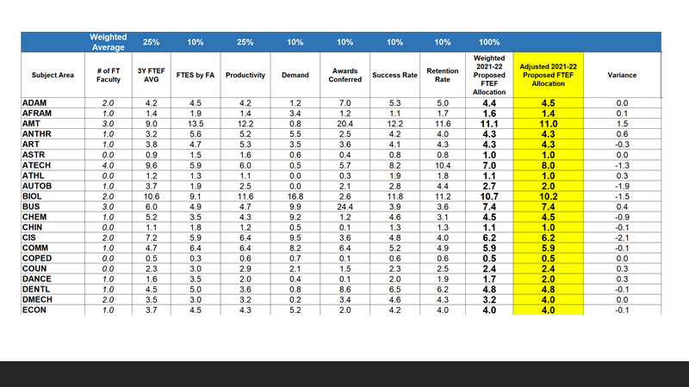

Slide 12
