Slide 1

Guided Pathways Planning Steering Group Meeting #1
February 2, 2018
12:00 – 2:00 p.m.

Slide 2
Time | Agenda Items
12:00 p.m. | Bring your own lunch!
12:00 – 12:15 p.m. | Introductions and Warm Up Introduction of planning group members Warm up
12:15 – 1:00 p.m. | Guided Pathways – What Is It? Chancellor’s Framework What others have focused on Resources
1:00 – 1:35 p.m. | What’s in a Plan? What does our final plan need to look like? How will we get there? Roles and responsibilities Timeline March 1-2 Guided Pathways Workshop in Oakland
1:35 – 2:00 p.m. | Communications How will the group communicate with the larger COA community?

Slide 3
Introductions
Anna O’Neal (Classified)
Muriel Montague (Classified)
Cady Bow (FT Faculty - Instruction)
Carolyn Johnson (FT Faculty - Instruction )
Edwin Towle (FT Faculty – Student Services)
Mary Shaughnessy (FT Faculty – Student Services)
Rachel Antrobus (PT Faculty)
Tracey Coleman (PT Faculty)
Don Miller – Vice President of Instruction
Tina Vasconcellos – Vice President of Student Services
Karen Engel – Interim Dean of Research & Planning - facilitator

Slide 4
Warm Ups – Meeting Norms
Cell phones off
Laptops ok for notes but Don’t be doing other work!
Listening with respect assuming positive intent (careful we don’t attack one another)
Define terms clearly, especially acronyms
Have a designated note-taker
Ok to call each other on these norms – but with humor!

Slide 5
Warm Ups
One thing you know about Guided Pathways
Two things you’d liked to know about Guided Pathways (at CoA)

Slide 6
Guided Pathways – What is it?
How does the Guided Pathways Framework deepen our efforts to help address Student Momentum Loss Points?

Slide 7
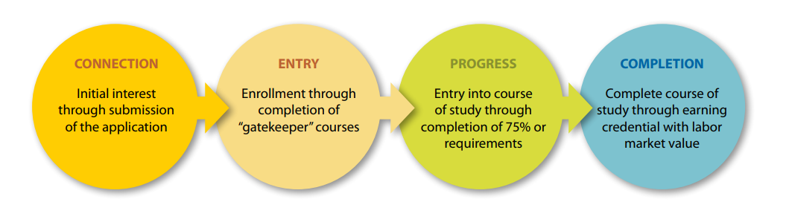
4 phases of a student’s journey
“Each phase entails interactions with the college that can make the difference between achieving their goals, or leaving the college with nothing to show for it.”
If students are not completing their journey – achieving their educational goals – on time, why not?
Source: Completion by Design initiative, 2012

Slide 8
Possible loss points…
Takes an assessment test without adequate preparation
Selects a major without information about what it means
Finds out required courses are full
Does not know there are financial incentives to remain full time
Drops to part-time and spends less time on campus, feels less connected
Changes majors and needs to “start over”
Stops out, believing they will return next year
Source: RP Group, Understanding the Student Experience Through the Loss/Momentum Framework

Slide 9

86% of CoA students have
“Earn an Associate’s Degree”
as their educational goal
but only 2% of CoA non-first time students actually earn an Associates Degree
in a typical year (258)
Source: CoA active Student Education Plan (SEP) data as of November, 2017

Slide 10
75% of CoA students have “transfer to a
4-year college or university” as a goal
but only 2% of non-first-time students actually transfer to a 4-year college or university in a typical year (250)
Source: 2017 CCSSE data
Notes:
Goals
Students were asked to indicate their reasons or goals for attending this college; students could choose more than one reason. 67% are taking classes for self improvement or personal enjoyment, while 39% indicated that they hope to change careers. 52% wanted to obtain or update job-related skills, while 75% plan to transfer to a 4-year institution. 53% aim to complete an associate degree, while 38% plan to complete a certificate program at the college (survey item #26, Standard Reports for [College Name]/All Students/Frequencies).

Slide 11
CoA First-time students….need to earn 60 units in 2 years to complete an AA/AS “on time”
665
First Time
College Students
2 years
52%
Do not persist from Fall to Spring
22%
Successfully complete 15+ units in Year 1
2%
Successfully complete 30+ units in Year 1
2015-16 first-time students. Source: State Chancellor’s Office KPI data for Guided Pathways

Slide 12
CoA First-time students….have difficulty placing into and successfully completing English & Math
665
First Time
College Students
1 year
39%
Placed into
transfer-level
English
32%
Placed into
transfer-level
Math
13%
Complete
transfer-level
English
12%
Complete
transfer-level
Math
6%
Complete
transfer-level
English & Math
2015-16 first-time students. Source: State Chancellor’s Office KPI; PCCD BI Tool

Slide 13
At CoA, students are asked to choose from 69 different degree and certificate programs

Slide 14
At CoA, students are asked to choose from 69 different degree and certificate programs
Of CoA’s active Academic Plans, 409 students (6%) have chosen a degree program that is currently not possible to achieve at CoA

Slide 15
At CoA, students are asked to choose from 69 different degree and certificate programs
Of CoA’s active Academic Plans, 409 students (6%) have chosen a degree program that is currently not possible to achieve at CoA
For example, 50% of CIS courses are not being offered, making it impossible to earn an AA degree in CIS despite it being the 5th most sought after degree program

Slide 16
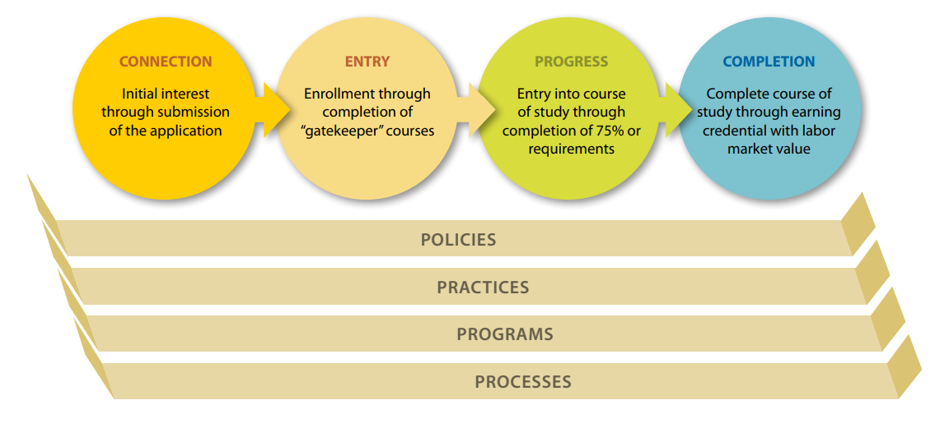
Are we the problem?

Slide 17





Four pillars of Guided Pathways
Create clear
curricular
pathways to
employment
and further
education.
Help students
choose and
enter their
pathway.
Help students
stay on
their path.
Ensure that
learning is
happening
with
intentional
outcomes.

Slide 18

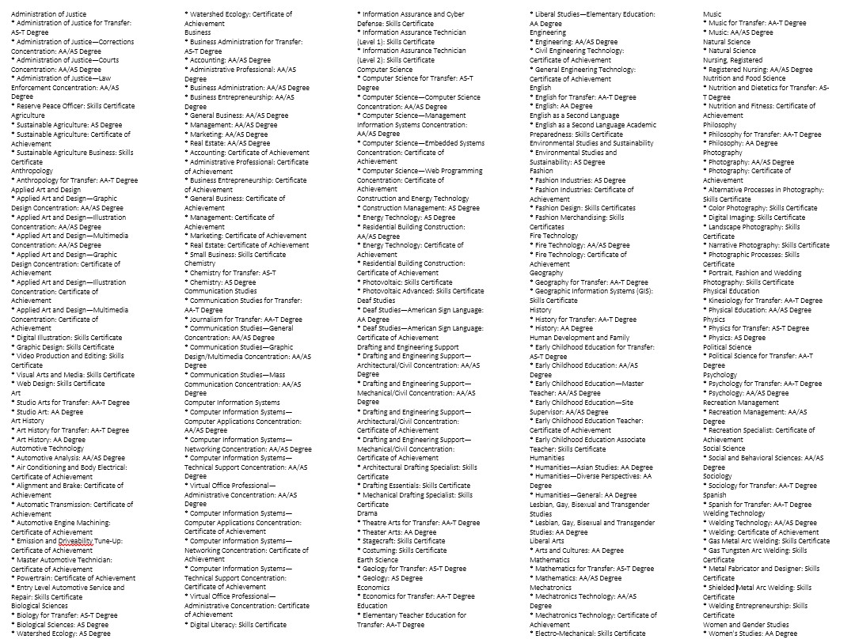
Clarify the Path – interest areas v. a specific major
AFTER: 9 Interest Areas
BEFORE: 150+ Degrees and Certiﬁcates

Slide 19
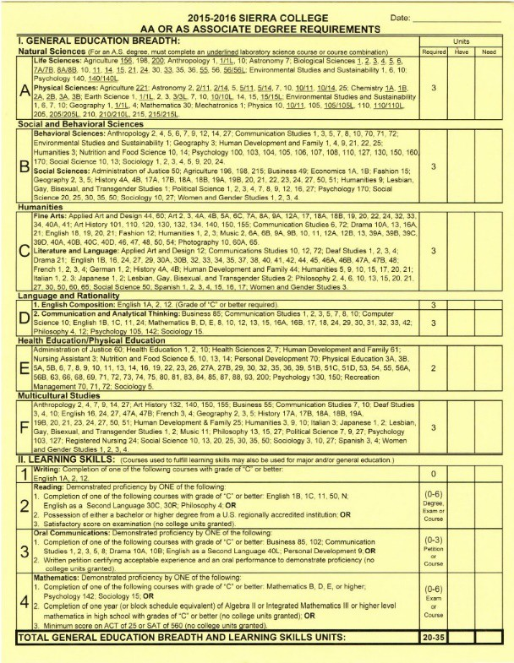
Clarify the Path – create simpler academic maps
Select 10 courses from this list of 543
Award name: Anthropology AA-T
YEAR ONE
Fall Semester | Units | Spring Semester | Units
MAJOR REQUIREMENTS |  | MAJOR REQUIREMENTS
ANTH 1 | 3 | ANTH 5 | 3
ANTH 1L | 1 | ANTH 6 | 3
ANTH 2 | 3
MAJOR ELECTIVES |  | MAJOR ELECTIVES
GENERAL EDUCATION (for degree or transfer) |  | GENERAL EDUCATION (for degree or transfer)
ENGL 1A | 3 | ENGL 1B or PHIL 4 | 3
SOC 15 or MATH 13 | 3-4 | HIST 18A, 18B, 25, or 27 | 3
Transferable Elective | 1-2 | Transferable Elective | 3
Total Semester Units: | 15 | Total Semester Units: | 15
YEAR TWO
Fall Semester | Units | Spring Semester | Units
MAJOR REQUIREMENTS |  | MAJOR REQUIREMENTS
ANTH 7 or ANTH 4 | 3
MAJOR ELECTIVES |  | MAJOR ELECTIVES
 |  | ANTH 9 or ANTH 10 or ANTH 12 or ANTH 14 or ANTH 27 | 3
 |  | ANTH 9 or ANTH 10 or ANTH 12 or ANTH 14 or ANTH 27 | 3
GENERAL EDUCATION (for degree or transfer) |  | GENERAL EDUCATION (for degree or transfer)
COMM 3 or COMM 5 | 3 | SSCI 50 or ARHI 132 or ARHI 140 or ARHI 150 or ARHI 155 | 3
PSYC 130 or HDEV 1 or NUTF 10 | 3 | SSCI 25 or LGBT 2 or WMST 3 | 3
GEOG 1 or ESCI 10 or ESCI 1 | 3 | POLS 1 | 3
Transferable Elective | 3
Total Semester Units: | 15 | Total Semester Units: | 15
 |  |  | 60

Slide 20

Clarify the Path
Provide a class schedule that aligns with students’ needs (education plan data)
  Block schedule allows a.m. and p.m. degree options
  Block schedule increases efficiency

Slide 21

Get students on the path
Launch first-year experience cohorts aligned with college promise initiatives
Design survey courses as program “samplers”?
Create non-credit to credit “on-ramps”

Slide 22

Making informed choices with career in mind
College and Career Readiness classes at scale
  At High Schools (dual enrollment)
  At Adult Schools and community-based organizations
Work Experience classes at scale
  Student explore careers while earning transferrable credits
Partnerships with the One Stop Career Center and employers
  Leverage resources to help students make more informed choices

Slide 23
Minimize the time required to get “college ready”
Create and scale “just-in-time” remedial, co-requisite courses in English and math for students who are not college ready
Offer some remedial English and math classes as non-credit (free, repeatable)
Use high school transcript data to improve placement accuracy
Inform students of choices to enable “self-report” and “self-placement”
Work with Adult Schools to help assess and place immigrants

Slide 24

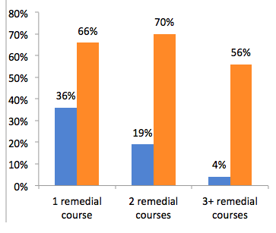
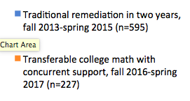
Transfer-Level Math Completion by Placement Test Results
14X higher for lowest-placed group

Slide 25
AB 705
We may not require students to enroll in remedial English or math courses that lengthen their time to complete a degree unless they are “highly unlikely” to succeed in transfer level courses
We must “maximize the probability” that a student will completed the required college-level coursework in English and math within a one-year timeframe.
We must “minimize the impact” on student financial aid by exploring embedded support and low or noncredit support options

Slide 26

Embed student support within instruction
Supplemental instruction
Tutoring (peer)
Co-requisites
Intrusive counseling

Slide 27

Ensure students know the requirements to succeed
Grad Guru
Communications campaign
Check terminology

Slide 28

Monitor student progress and proactively provide feedback
Early Alert
Monitor students’ progress on the path (degree audit) and provide "off track" alerts
Reach out to “stop outs”

Slide 29

Ensure learning is happening
Revisit our “loss point” data regularly to see how we’re doing
Evaluate program outcomes
Evaluate institutional learning outcomes

Slide 30
Resources
CoA & District subject matter “experts”
California Community Colleges Guided Pathways (CCCCO)
California Guided Pathways Project (20 early colleges)
American Association of Community Colleges – national cohort
RP Group: Research & Planning for California Community Colleges
Career Ladders Project

Slide 31
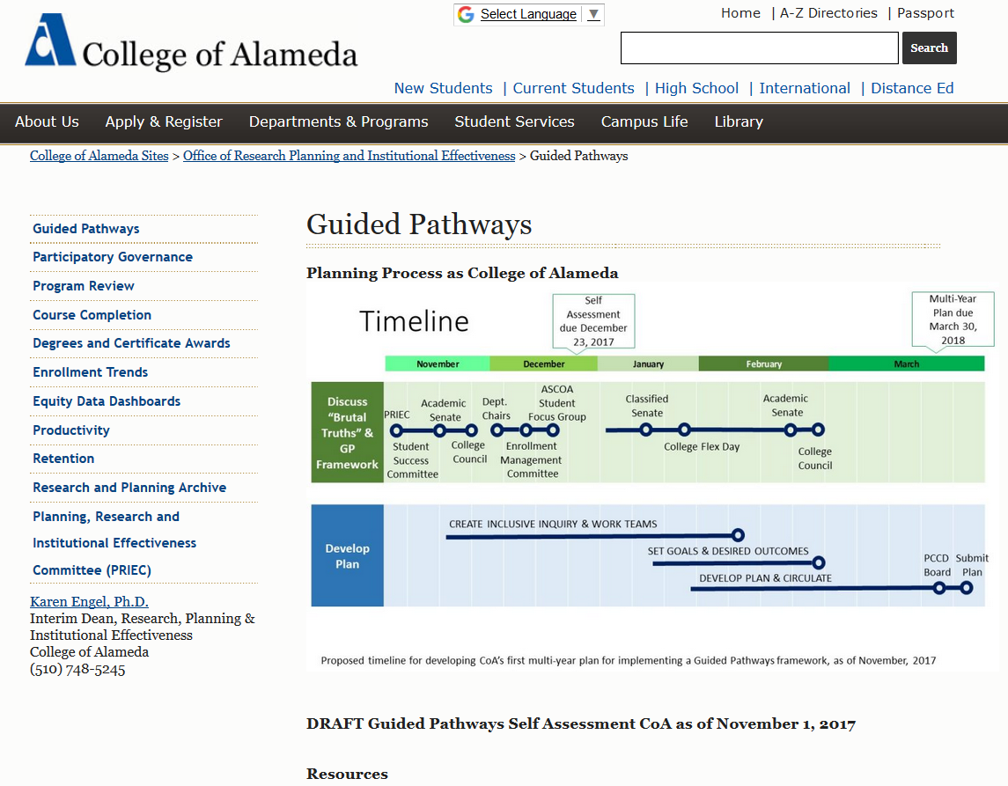

Slide 32
What’s in a Plan?
Key Element
Inquiry | 1. Cross-Functional Inquiry
 | 2. Shared Metrics
 | 3. Integrated Planning
Design | 4. Inclusive Decision-Making Structures
 | 5. Intersegmental Alignment
 | 6. Guided Major and Career Exploration Opportunities
 | 7. Improved Basic Skills
 | 8. Clear Program Requirements
Implementation | 9. Proactive and Integrated Academic and Student Supports
 | 10. Integrated Technology Infrastructure
 | 11. Strategic Professional Development
 | 12. Aligned Learning Outcomes
 | 13. Assessing and Documenting Learning
 | 14. Applied Learning Opportunities
Review state plan template
Choosing 3-6 to focus on in year 1
What questions do we have as we think about what to prioritize this year?

Slide 33

How will we get there?
Collaboration is key – especially across student services and instruction
Reflect on what we don’t know and ask questions
Which changes are likely to affect the largest number of students?
What’s feasible?
What changes can we implement in a year? Two years?

Slide 34
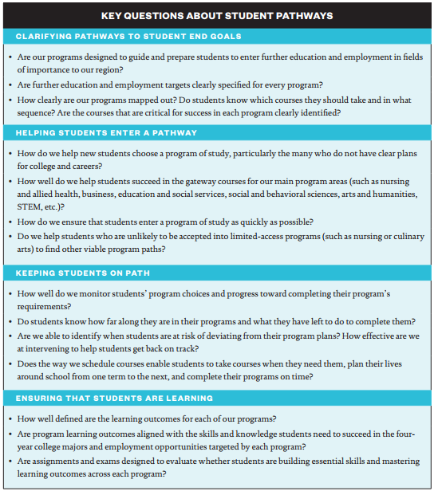
Source: Columbia University, Teachers College
Community College Research Center

Slide 35
Roles and responsibilities
Help develop the draft Guided Pathways plan for CoA
Faculty stipend for 18 hours (over 5-6 weeks)
  1. Review information and be prepared to contribute to plan development.
  2. Communicate and present to faculty groups related to Guided Pathways Framework.
  3. Collect, compile, analyze and interpret feedback to support plan development.
  4. Assist college faculty and staff in documenting Guided Pathways planning.
  5. Attend scheduled meetings

Slide 36
Planning meetings every Friday
February 9 – hold 3 hours
February 16th is a holiday!
February 23 – 5 hours?
All day March 1 attend GP workshop in Oakland
March 2nd in Oakland is optional (half day)
March 5-9: Plan to circulate to participatory governance committees
To PCCD Board by March 13 for March 27 meeting (latest)
Due to state on March 31, 2018

Slide 37

Communication
Setting up a Team Site to share and work on documents together
How will this group communicate with the larger CoA community?

Slide 38
Homework
Accept Sharepoint Team Site membership
Review Planning Template
Review Self Assessment
Review today’s slides, other resource on the website
Discuss ideas with your colleagues!

Slide 39
See you next Friday

