Slide 1
Success Metric: Retention
Online Course Enrollment for Disproportionately Impacted Groups
+23% increase compared to 2017
Notes:
Did we increase the number of disproportionately impacted students who successfully completed an online course and enroll in the following term by 20% by June 2020? Yes. For the African American and Latinx student population ( both groups that have reflected disproportionate numbers in 2017) the number online course enrollments rose by 23% and 44% respectively in 2019.

Slide 2
Success Metric: Transfer to a Four -Year Institution
No. of Comprehensive SEPs for Matriculating Students
1148 of 2088 (55%) matriculating students received a COMP SEP
Notes:
Did we increase the number of full and part time matriculating students with a comprehensive education plan to 80%? No. In 2017-18, comprehensive SEPs for matriculating students at College of Alameda rose by 20%, however by 2019, the number of COMP SEPs began to decline. For 2020, the percent of COMP SEPS compared to the base line in 2017 fell by -3%

Slide 3
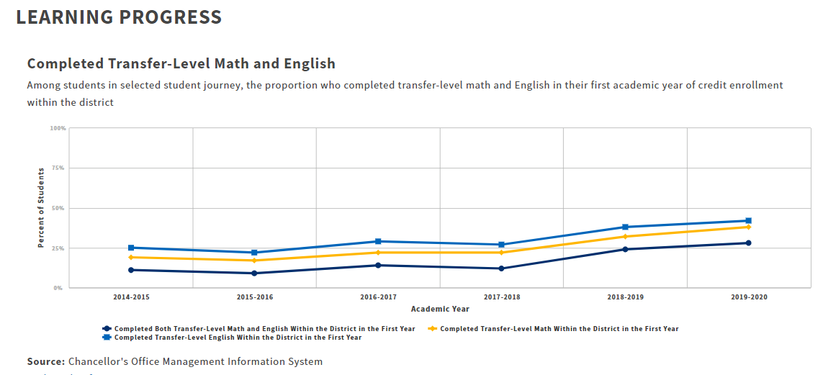
Success Metric: Complete Both Transfer-level Math and English in the first academic year
223 of 936 students Completed both transfer level English & Math within their 1st year (24%)
257 of 927 students Completed both transfer level English & Math within their 1st year (28%)
124 of 1003 students Completed both transfer level English & Math within their 1st year (12%)
121 of 858 students Completed both transfer level English & Math within their 1st year (14%)
Source: CCC Student Success Metrics Dashboard https://www.calpassplus.org/LaunchBoard/Student-Success-Metrics.aspx
Notes:
Did we increase the number of first-time students who complete a transfer level English and math course within one academic year by 50%? Yes. In 2017-18, the percent of first-time degree and transfer seeking students who completed transfer English and math within their first year was 14%. Since the implementation of AB705 practices that includes Self Guided Placement, the number of students completed both areas has more than doubled in 2019-20.

Slide 4
Success Metric: Attained Vision 2022 Completion Goal
Degrees & Certificates Conferred By Year
797
821
732
746
690
Notes:
Did we increase the number of students who complete a certificate or degree by 10% by June 2020? No, however in 2018-19 awards rose by 12% or 89 awards compared to 2016-17. In 2019-20, the number of awards conferred dropped by 2% compared to our baseline of 732 in 2016-17. It should be noted by June 2020, all face-to-face courses had been transitioned to online and student services were not available in person due to the peak of the COVID 19 pandemic.

